Slide 1
Video Games & Male Gaze
Brought to you by:
Boitumelo Monaledi
Gabriel Mortier
Basel Hussein
Supreem Thapa
Daria Roth

Slide 2
Agenda
Introduction
Question 1
Question 2
Conclusion
Goodbye

Slide 3

Introduction

Slide 4
Male Gaze
The male gaze theory proposes that some media is directed towards men through the sexualization of women, such as showing them in provocative ways or only as objects to be used by men.

Slide 5
What are tropes?
Tropes are recurring themes or clichés that appear across different games. They simplify complex characters into predictable roles, often reinforcing outdated gender norms.

Slide 6
Damsel In Distress
Female characters are frequently portrayed as needing rescue, reinforcing passive and helpless roles.

Slide 7
Women as trophies
Women are often depicted as rewards for male characters' achievements, reducing them to mere prizes.

Slide 8
Mercy Killing
Female characters are sometimes portrayed as victims who need to be 'put out of their misery,' emphasizing their vulnerability.

Slide 9
Refrigerator in a box
This trope involves women being harmed or killed to motivate the male protagonist, sidelining their own stories.

Slide 10
Why Do Tropes exist in the first place?
Origins of the Industry
Target Audience
Power Dynamics
Developer Demographics
Community Influence

Slide 11
Question 1
How has the representation of female lead characters in video games evolved over time, and to what extent are they sexualized in these roles?

Slide 12
Why the importance for a female lead?
Representation and Inclusivity
Broadening Audience Appeal
Challenging Stereotypes
Social Impact

Slide 13
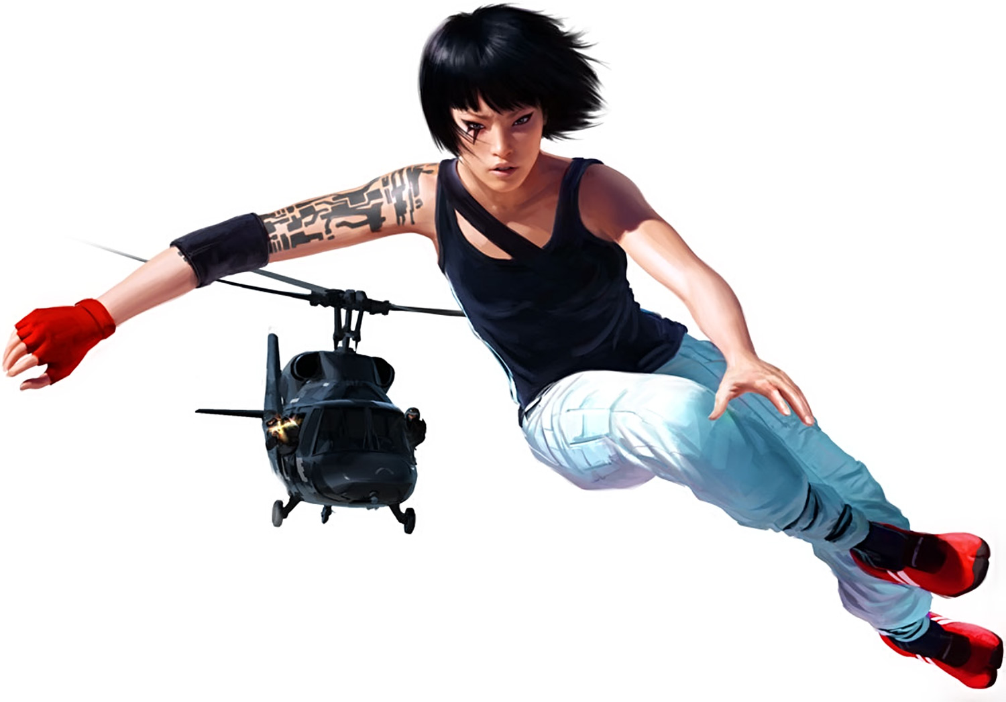
Example of female lead
Faith Connors
Critics consider Faith Connors a significant game character in popular culture.
As the protagonist of the Mirror's Edge series, she is praised for her agility and unique parkour-based gameplay.

Slide 14

Sexualisation
Faith stands out as a strong, independent, and non-sexualized female lead, breaking away from typical game character archetypes.
Her role has sparked discussions about diversity and representation in games, with viewpoints ranging from a positive step forward to debates on her character's development.

Slide 15
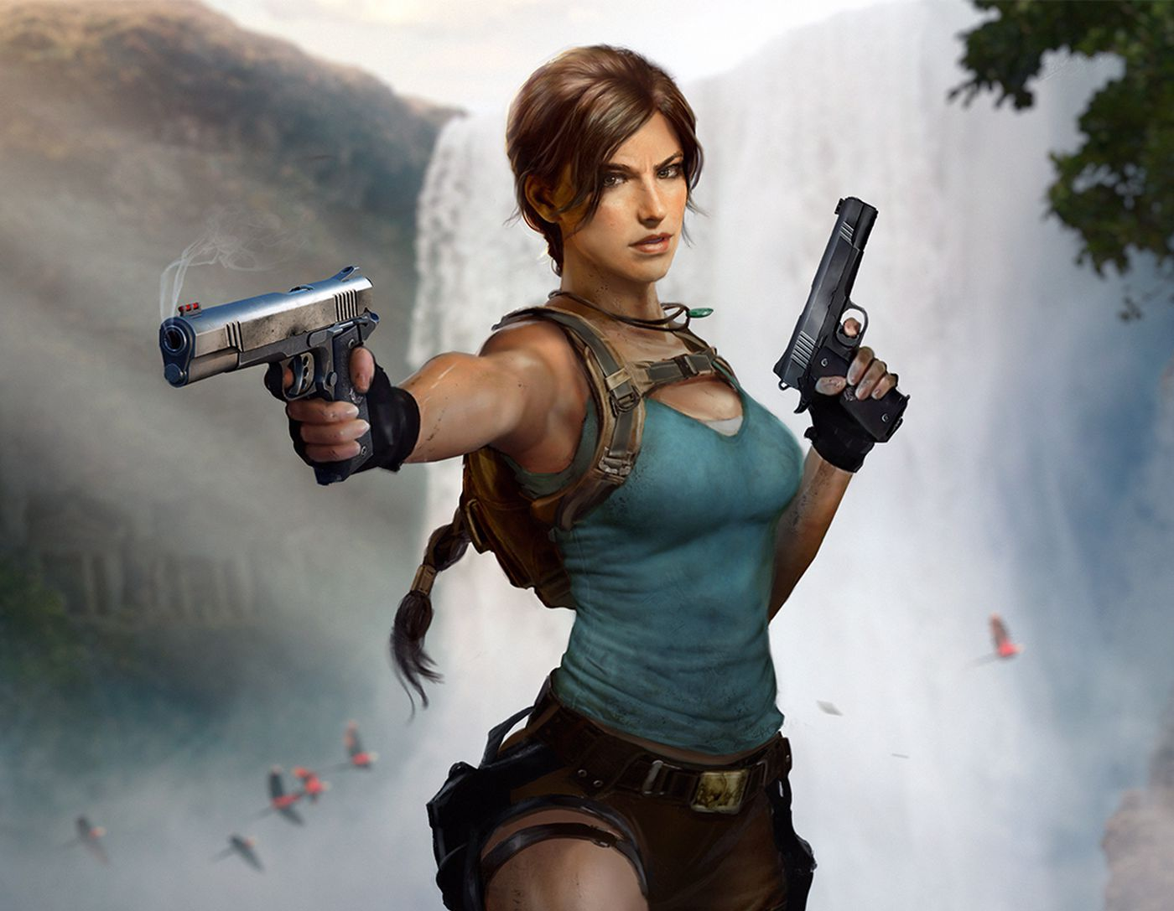
Example of female lead
Lara Croft
Lara Croft is a character and the main protagonist of the video game franchise Tomb Raider.
Critics consider Lara Croft a significant game character in popular culture.
She is among the first video game characters to be successfully adapted to film.

Slide 16
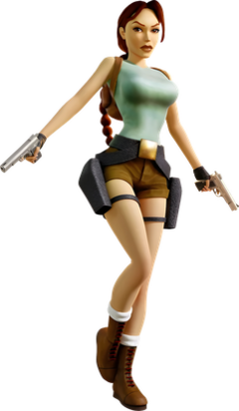
Sexualisation
Lara Croft is also considered a sex symbol, one of the earliest in the industry.
Viewpoints range from a positive agent of change in video games to a negative role model for young girls.
Australian feminist scholar Germaine Greer criticised her as an embodiment of male fantasies.
Lara Croft from Tomb Raider I-III Remastered in her signature outfit worn in many games.

Slide 17
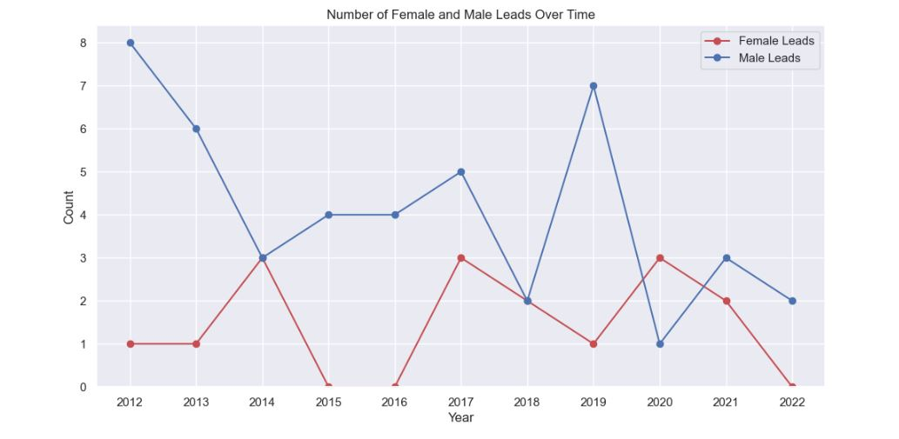
Based on data given

Slide 18
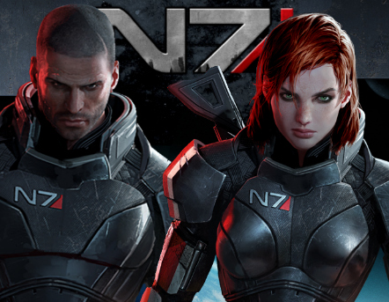
Example of Custom lead
Commander Shepard
Critics consider Commander Shepard a significant game character in popular culture. As the protagonist of the Mass Effect series, Shepard is praised for their deep customization and player-driven narrative.
Shepard's character, whether male or female, is recognized for embodying leadership and moral complexity, breaking new ground in video game storytelling.

Slide 19
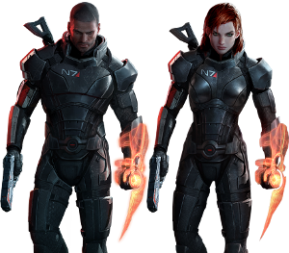
Sexualisation
Shepard's sexualization has sparked discussion, with the series' romantic subplots praised for inclusivity and depth.
While some see this as a progressive step for representation and player agency, others debate its impact on the game's broader narrative and character development.

Slide 20
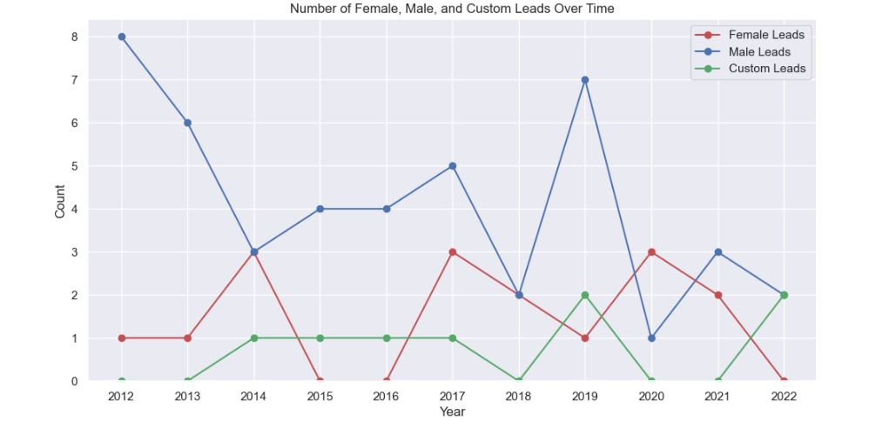
Based on data given

Slide 21
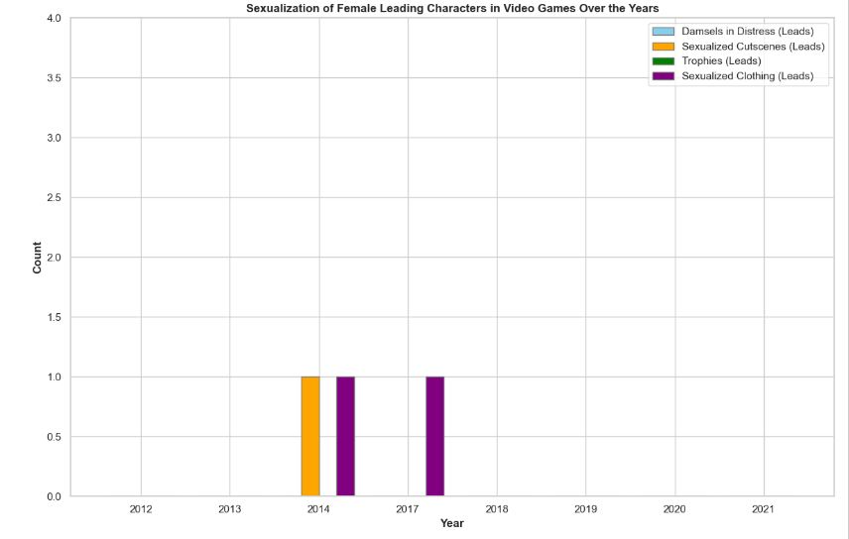
Based on data given

Slide 22
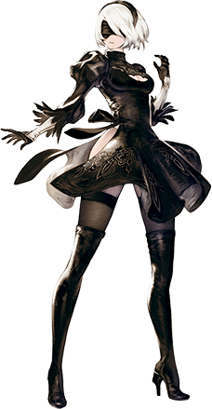
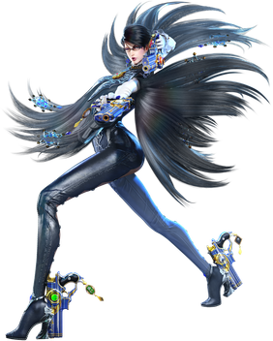
examples
YoRHa No.2 Type B,
one of the protagonists of NieR:Automata.
Bayonetta,
Main protagonist of the Bayonetta video
game series.

Slide 23
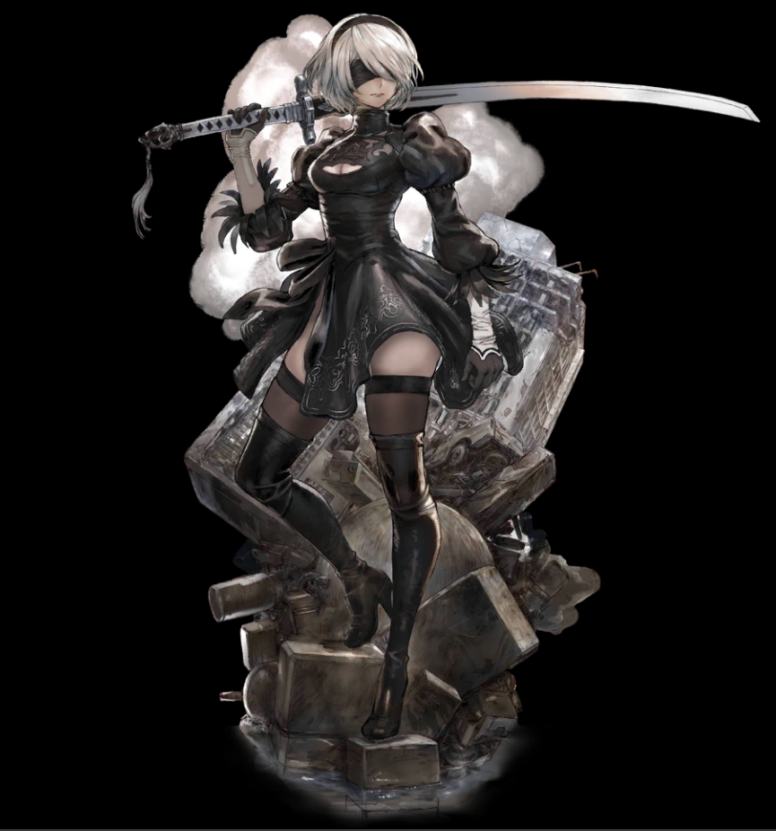
How are they being sexualised
YoRHa No.2 Type B
Revealing Outfit which emphasises her figure and exposes a lot of skin.
Suggestive Camera Angles: Throughout the game, camera angles often emphasise 2B's body.
These angles often highlight her physique and can come across as suggestive.
Marketing and Fan Service:
2B can be seen as a form of fan service, appealing to players who appreciate attractive character designs.
This is a common tactic in various media to engage a particular demographic.

Slide 24
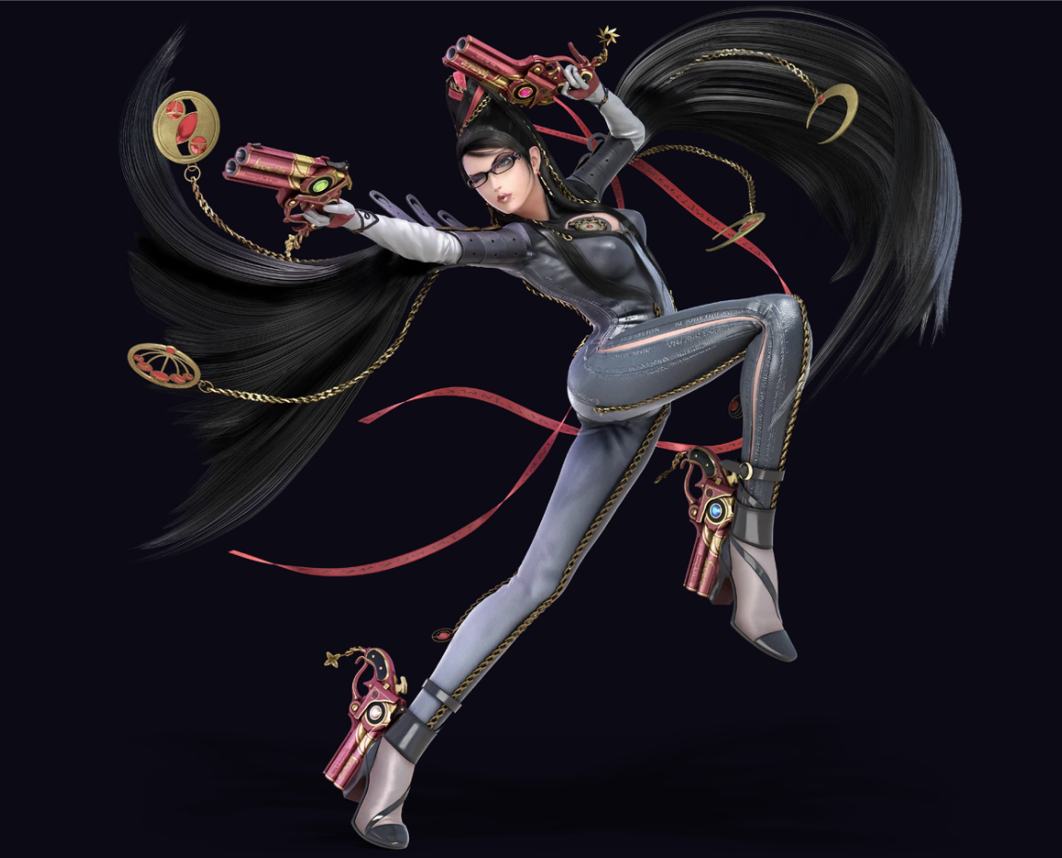
How are they being sexualised
Bayonetta
Bayonetta’s attire is a skintight bodysuit.
This design accentuates her physical form in a very pronounced way.
Suggestive Camera Angles:
Throughout the game, angles are crafted to highlight her physique and contribute to a sexualized portrayal.
Marketing and Fan Service:
Similar to 2B, Bayonetta’s design reflects certain aspects of Japanese gaming and anime culture, where characters are often depicted with exaggerated sexual features and attire to appeal to specific audiences.

Slide 25
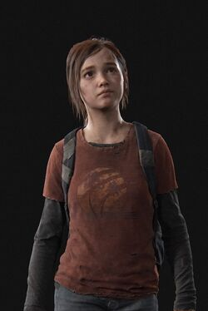
Question 2
Over time, has the portrayal of female characters and NPCs in video games as sexualized or stereotyped figures decreased or increased, and have there been new methods of such portrayal?

Slide 26
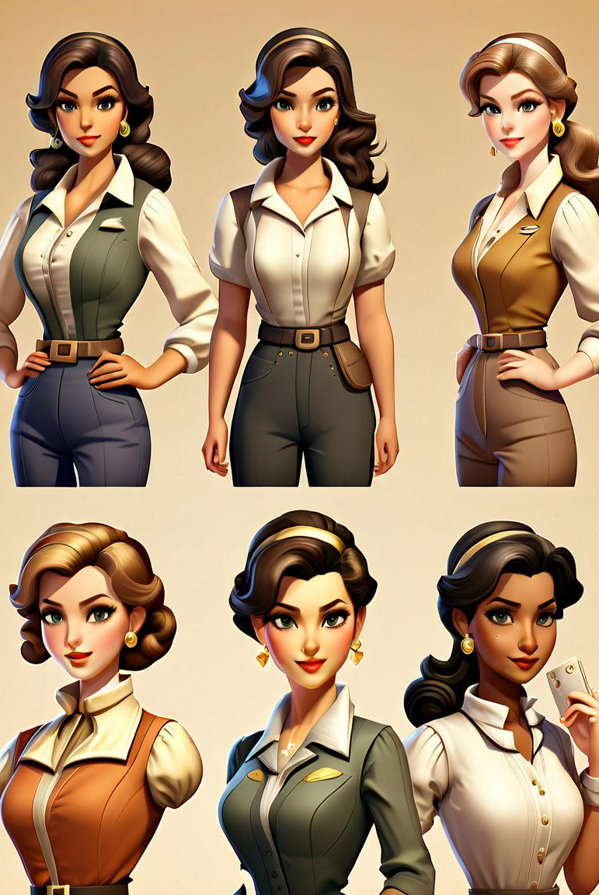
Portrayal of Female Characters in Video Games: Trends and Insights
Over the past decades, the representation of female characters in video games has placed a significant image on female characters in the gaming world. portrayals often relied on stereotypical and sexualized depictions, Many gaming industries have historically relied on the sexualization of female characters as a marketing strategy to attract a predominantly male audience. This practice often involves designing characters with exaggerated physical features. revealing clothing, and stereotypical roles that cater to the male gaze. These portrayals are frequently justified by claiming they enhance the game's visual appeal or align with certain genre conventions, but they perpetuate harmful stereotypes and undermine efforts for more diverse and respectful representations in the gaming community.

Slide 27
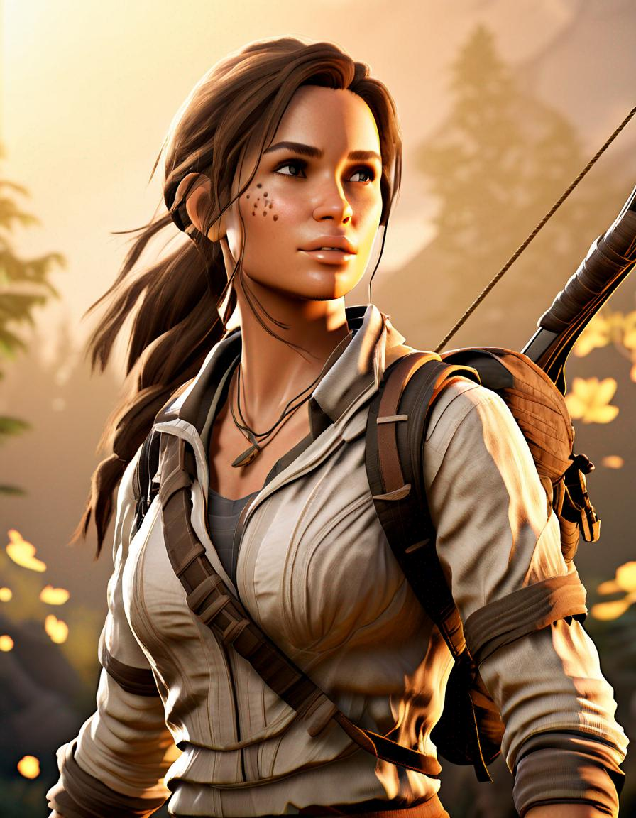
Shifting perspectives
Early Stereotypes
female characters were often depicted as passive, objectified, or relegated to minor support roles, reinforcing traditional gender norms.
Emerging Empowerment
Increasingly, video games feature female protagonists who are strong, complex, and take on leading roles, challenging traditional stereotypes.
Inclusive Representation
The industry is moving towards more diverse and inclusive representation, with a wider range of body types, ethnicities, and narrative roles for female characters.

Slide 28

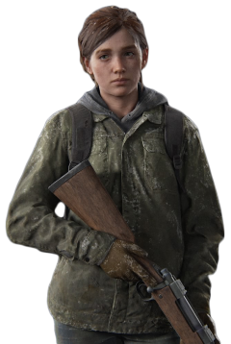
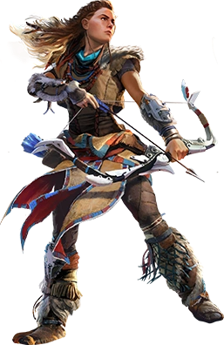
Characters that faced sexualization in the past
1
Lara Croft (1996)
The iconic Tomb Raider series introduced an adventurous female character with rather exaggerated body features
2
Aloy (2017)
Horizon Zero Dawn featured Aloy, a skilled hunter and warrior, although faced with proper representation , the character still represents some physical moves that can be considered sexual and unethical
3
Ellie (2013, 2020)
The Last of Us series showcased Ellie, a resilient and resourceful young woman, was shown in several sexual cases in the infamous last of us video game and movie series

Slide 29

Ongoing Challenges and Opportunities
1
Representation Gaps
2
Objectification Concerns
Despite progress, there are still significant gaps in the representation of diverse female characters, especially in terms of race, age, and body type.
Some games continue to depict female characters in overly sexualized or unrealistic ways, which can perpetuate harmful stereotypes.
3
Inclusive Design Practices
4
Player Agency and Choices
Adopting more inclusive design practices and involving diverse teams can help create more authentic and empowering female characters.
Allowing players to create and customize their own female characters can foster a greater sense of representation and self-expression.

Slide 30
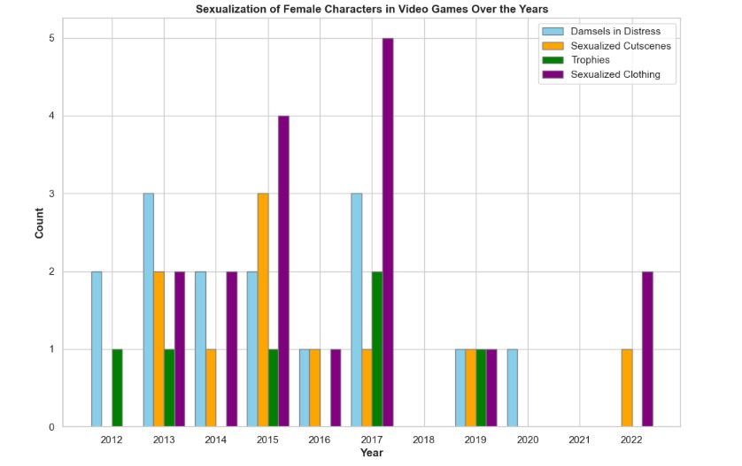
Data about

Slide 31
New Method of Portrayal.
Customizable Characters.
Diverse Body Types and Ethnicities.
Strong and Independent Characters.
Story mode.
Notes:
1>gender and identity options, diverse apperance.
2>have options for body type and skin colour.
3>have certain mission to do with action adventure ahead.
4>have option to choose the mode of the character.

Slide 32
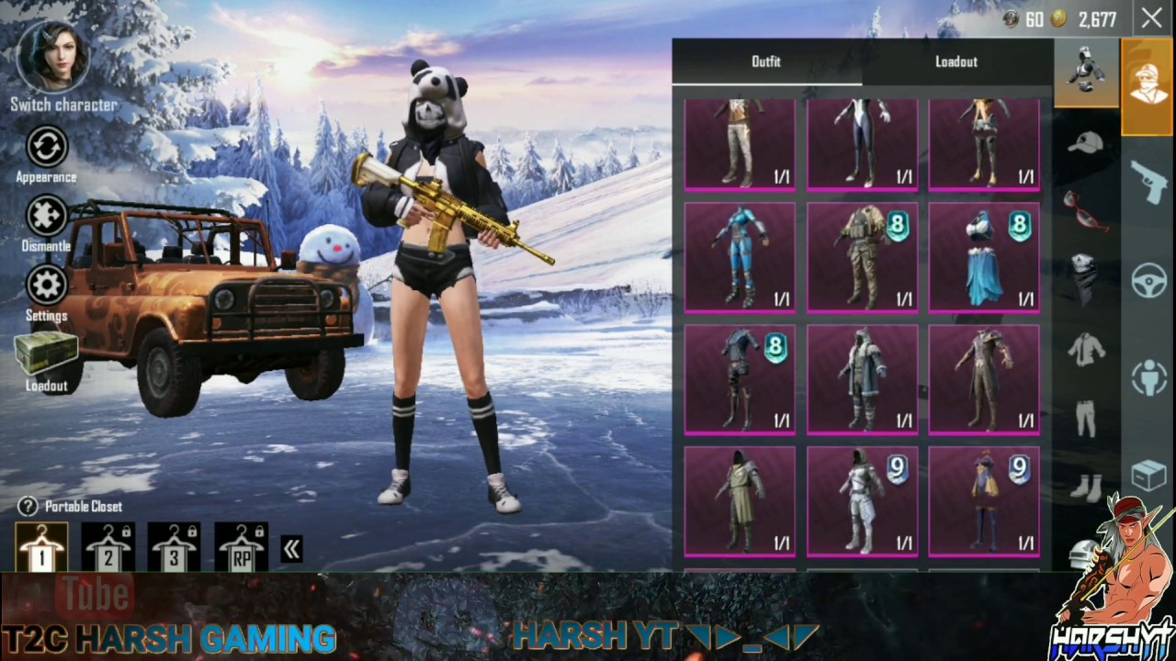
Customizable Characters.

Slide 33
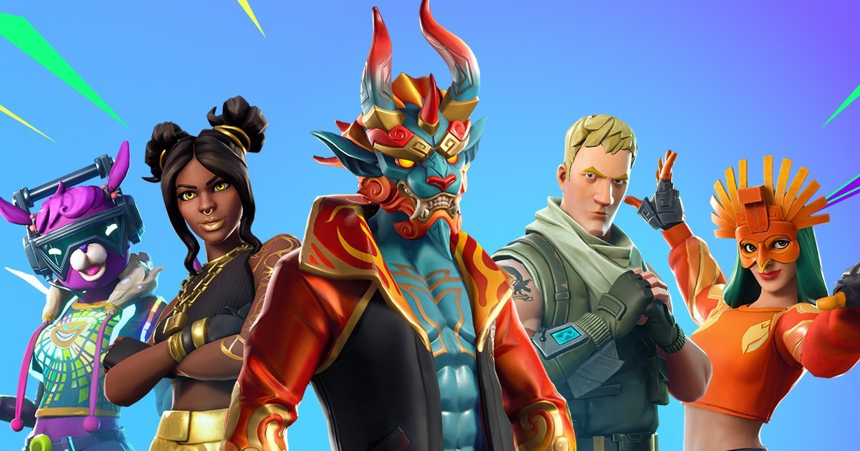
Species
Human
Humanoid
Humanoid-Anima
Android-Robot
Robots

Slide 34
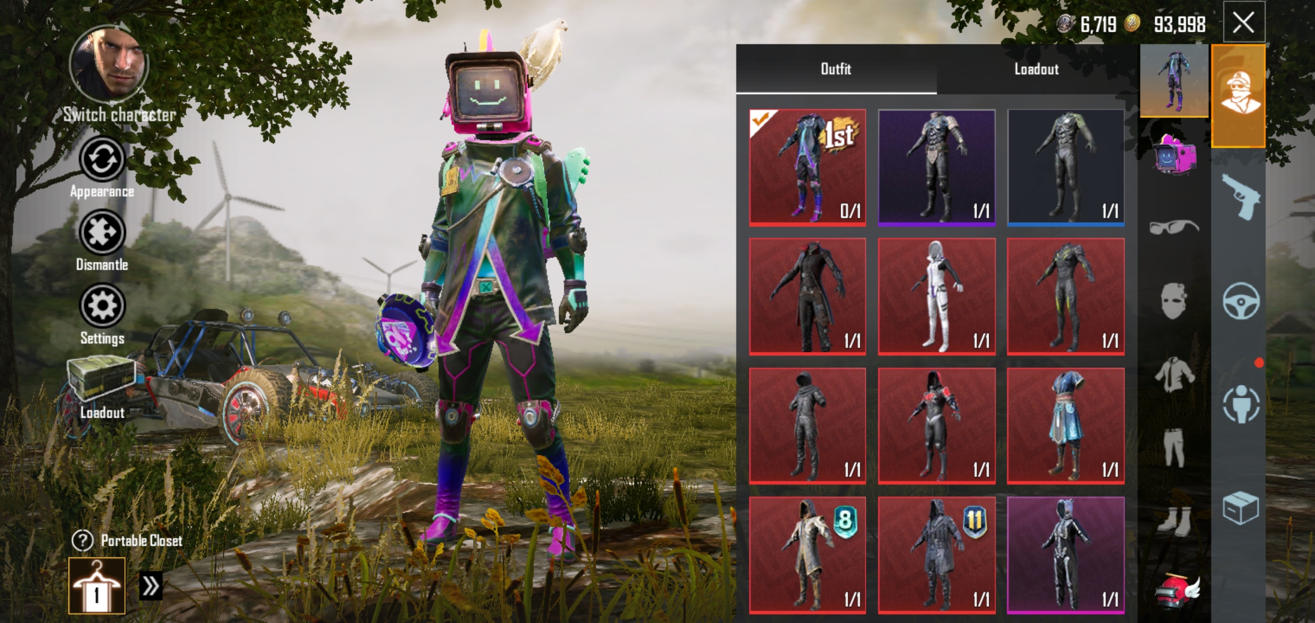
Image example 2

Slide 35
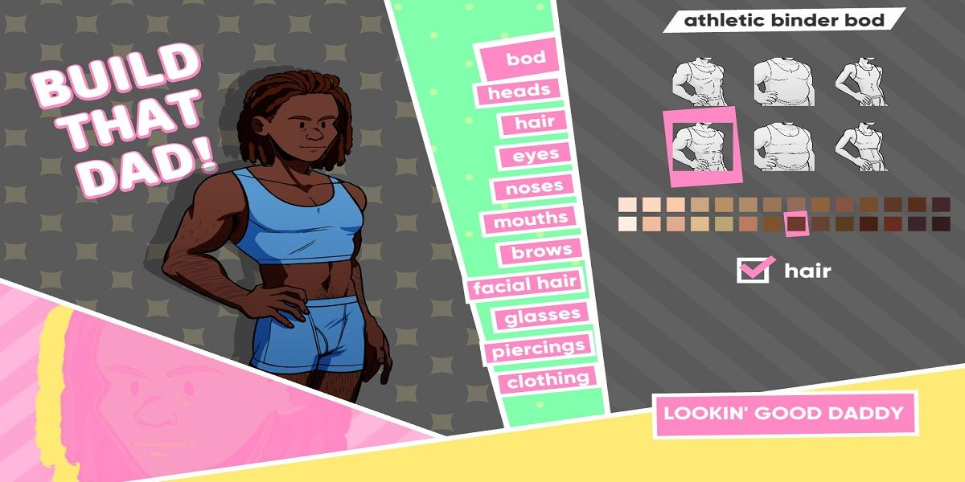
2. Diverse Body Types and Ethnicities.

Slide 36
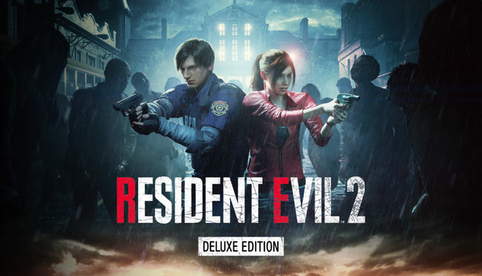
3. Story mode.

Slide 37

4. Strong and Independent Characters.

Slide 38
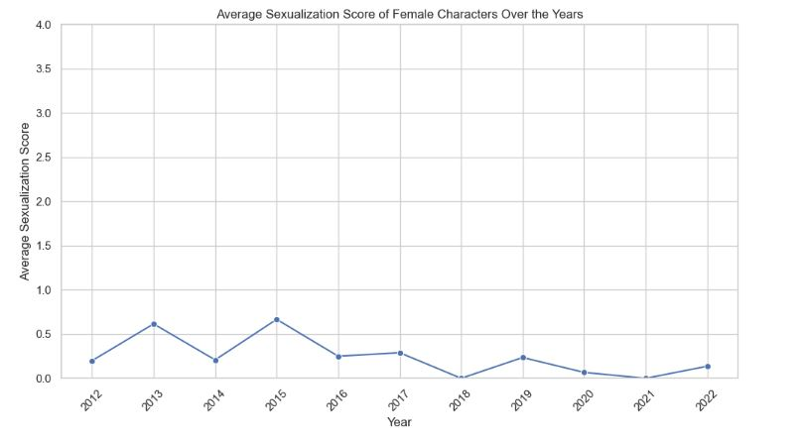
Here, data after new method of portrayal.

Slide 39
Gender game content
Representation of females within game.
General lack of female game character.
Gender space
Females are restricted from full access to many social space.
General lack of female game character.
Gender activities
Females are more affiliative and nurturing.
A solitary activity for male "nerd" or "geeks".

Slide 40
At last,
The sexulizations in video game is ongoing topic and is influenced by the following points:
Prevalence of Female gamers.
Gender representation in games.
Gaming spaces.
Social aspects of gaming.
Challenges and resistance.
Academic and societal prespectives.

Slide 41
Conclusion
The paper by Jo Bryce and Jason Rutter,
Relationship between gender and gaming is complicated.
Bryce and Rutter also mention for more research that includes the perspectives of gamers themselves and other factors such as age, class, and ethnicity.

Slide 42
THANK YOU
ANY QUESTIONS?

